Slide 1
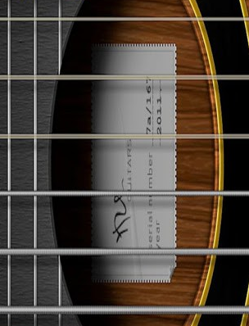

GUITAR NOTeTUNER
-An Approid Application

Slide 2
NoteTuner-
Guitar Notetuner is a very handy android application for tuning acoustics.
It has highly amplified Major standard notes.
It uses Simple and easy to understand interface for guitar players.

Slide 3
NoteTuner-
It is based on the classic Note tuning methodology.
In this methodology the guitar is tuned by hearing the Notes for the corresponding String.
It provides tuning for Standard Tuning namely EADGBE tuning.

Slide 4
How It Work-
It works like a classic guitar tuner.
It contains buttons for each standard open string notebaly-E A D G B e.
Clicking the play button will make the corresponding note play.
You hit the pause button to stop.
Similarly all the strings can be tuned.

Slide 5

Snap Shot-

Slide 6
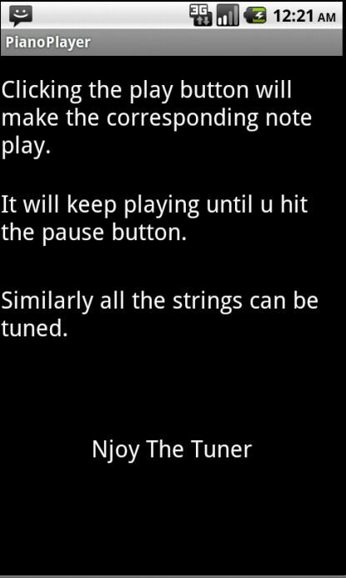
Snap Shot-

Slide 7
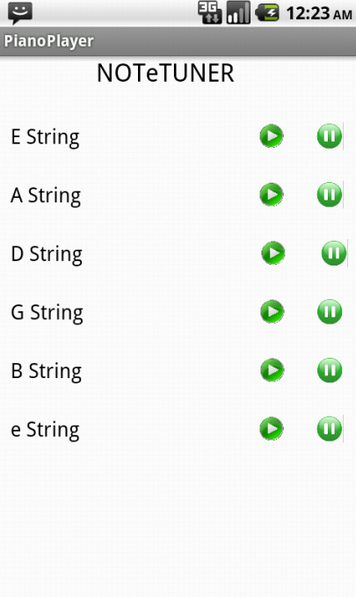
Snap Shot-

Slide 8
CHIEF CHARACTERSTICS-
1)It provide a simple interface tuning.
2)It is a small app thus consuming less memory.
3)It is loaded with boosted notes which makes them audible.
4)The play button helps in continuous play for the note.

Slide 9
THANKYOU

